Slide 1
What Drives Kenya's GDP Growth?
A Data Analysis and Regression Study Using World Bank Data Analyzing the relationship between: • Investment • Inflation • Government Expenditure • Unemployment Collins Mumo

Slide 2
The Question
Can key economic indicators help explain Kenya's GDP Growth?
Variables analyzed:
• Investment (% of GDP)
• Inflation (%)
• Government Expenditure (% of GDP)
• Unemployment (%)
Method used:
• Correlation Analysis
• Ordinary Least Squares (OLS) Regression

Slide 3
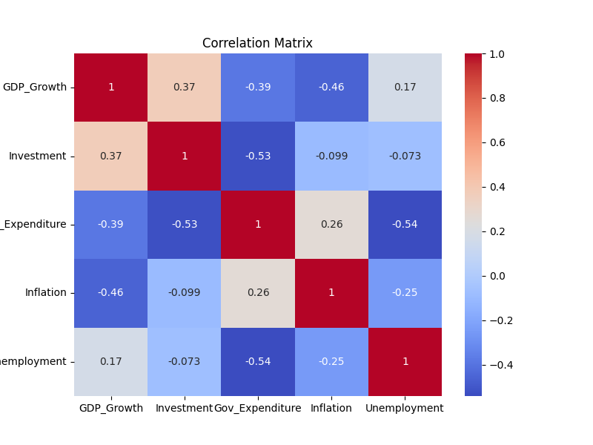
Exploring the Data
Correlation measures the strength and direction
of the relationship between variables.
Key observations:
• Investment showed a positive relationship with GDP Growth.
• Inflation showed a negative relationship with GDP Growth.
• Government Expenditure showed a weak relationship with GDP Growth.
• Unemployment showed a weak relationship with GDP Growth.
Correlation does not imply causation. These relationships were further examined using OLS regression.

Slide 4
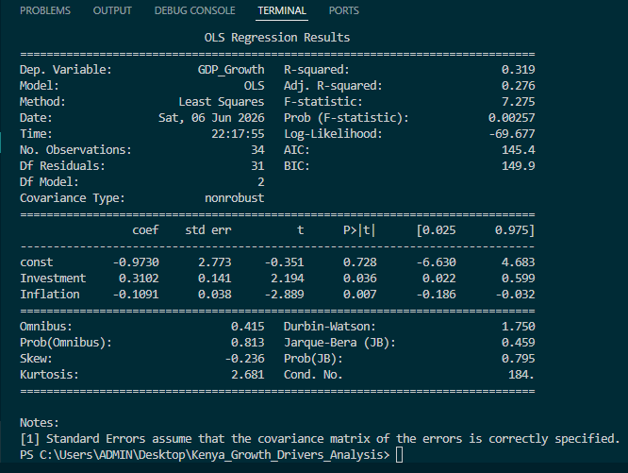
Regression Analysis
Final Model:
GDP Growth = f(Investment, Inflation)
Model Performance:
• R² = 0.319
• Statistically significant overall model
• No serious multicollinearity issues detected

Slide 5
Key Findings
Investment
Coefficient: +0.310
Investment was positively associated with GDP Growth.
A 1 percentage-point increase in Investment (% of GDP) was associated with approximately 0.31 percentage-point higher GDP Growth.
Inflation
Coefficient: -0.109
Inflation was negatively associated with GDP Growth.
A 1 percentage-point increase in Inflation was associated with approximately 0.11 percentage-point lower GDP Growth.
Statistically Significant Variables
✓ Investment
✓ Inflation

Slide 6
What Did Not Show Statistical Significance?
Government Expenditure
• Positive relationship
• Not statistically significant
Unemployment
• Weak relationship
• Not statistically significant
Not every variable that seems important
economically will be statistically significant
in a regression model.

Slide 7
Skills Applied
Data Collection
✓ World Bank Data
Data Cleaning
✓ Pandas
Data Transformation
✓ Reshaping
✓ Merging datasets
Exploratory Analysis
✓ Correlation Analysis
Statistical Modeling
✓ OLS Regression
Statistical Testing
✓ Hypothesis Testing
✓ P-values
✓ Confidence Intervals
✓ VIF
Visualization
✓ Heatmaps
✓ Scatterplots
✓ Time Series Charts

Slide 8
What Would You Add to the Model?
The model explained about 32% of the variation in Kenya's GDP Growth.
This suggests other factors may also play important roles.
If you were extending this analysis, which variables would you add?
• Exports
• Foreign Direct Investment (FDI)
• Exchange Rates
• Interest Rates
• Population Growth
• Something else?
I'd love to hear your thoughts.

